Slide 1
Mapping Raw DIA MS Data to OpenSWATH
Ira Horecka
Hannes Roest, Rotation 4, Winter 2022
2022-02-04

Slide 2
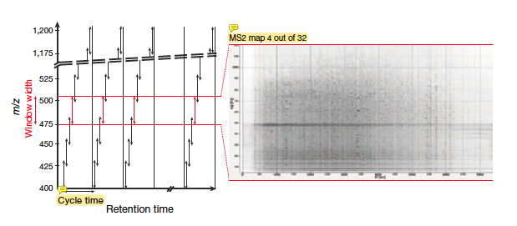
Conceptual background
Working with Data Independent Acquisition (DIA)
Fragments all precursors within predefined mass to charge (m/z) ratio and retention time (RT) range
Creates a complete 2D (m/z to RT) record of the fragment-ion signal from every sample precursor
Workflow of SWATH-MS (DIA method):
Isolate 25 m/z precursor windows
Fragment the precursors
Analyze the fragment ions on a time-of-flight (TOF) analyzer
OpenSWATH is an automated software for targeted DIA analysis
Accepts SWATH-MS data

Slide 3
Project background
Map raw DIA MS2 peaks (transitions) that are deemed significant by OpenSWATH
Raw transitions → Transitions from .mzML file (TimsTOF instrument)
Significant transitions → Transitions from .osw file with QVALUE < 0.01
Perform simple data analysis in two categories:
Across retention times
% raw transitions identified and labeled as significant by OpenSWATH
In one retention time window, assess flux in % identified raw transitions across:
m/z
Intensity
Ion Mobility

Slide 4
Data gathering and manipulation :: .mzML
Raw MS data (.mzML) is stored as an XML file
Josh C. provided an .mzML file with the following properties:
SWATH precursor window: 700 - 725 m/z
RT range: 2400 - 2700 sec
This window offers a feature-dense region for analysis
Use pyopenms to work with .mzML in an object oriented way

Slide 5
Data gathering and manipulation :: .osw
OpenSWATH file (.osw) is SQLite-compatible
Josh C. provided an .osw file with six runs, one of which is linked to the .mzML file.
.osw tables and columns of interest (bold columns = joining columns):
SCORE_MS2 :: [FEATURE_ID, QVALUE]
FEATURE_TRANSITION :: [FEATURE_ID, TRANSITION_ID]
FEATURE :: [FEATURE_ID, RUN_ID, EXP_IM, LEFT_WIDTH, RIGHT_WIDTH]
TRANSITION :: [TRANSITION_ID, PRODUCT_MZ]
Joined table row count: 30,066,277

Slide 6



Filtering strategy
Filtered Table
.mzML file
.osw
Iterate through spectra
Join tables
MZ within +/- 20 ppm
RunID == *1330_[...]_0.mzML
RT between
LEFT_WIDTH & RIGHT_WIDTH
QVALUE < 0.01
IM within +/- 0.05
Filtered table row count: 608,971
Notes:
~8.6% of rows in the .osw file had QVALUE < 0.01

Slide 7
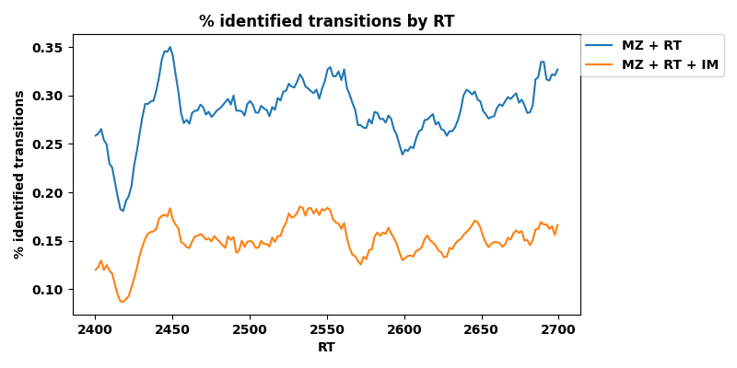
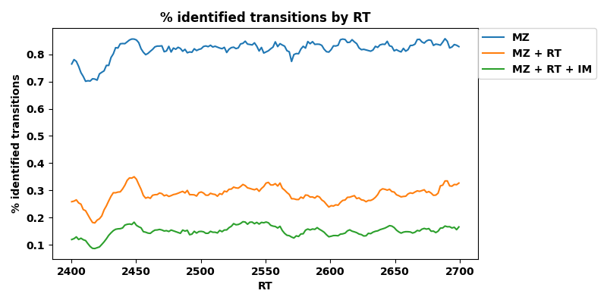
Looking at significant transitions across RT
The RT window is between 2400 and 2700 sec
How do % identified transitions compare among levels of filtration?

Slide 8
Looking at significant transitions @ RT: 2688.63
Isolate spectrum with RT of 2688.63 sec
Analyze % identified transitions as a factor of:
m/z
Intensity
Ion Mobility

Slide 9
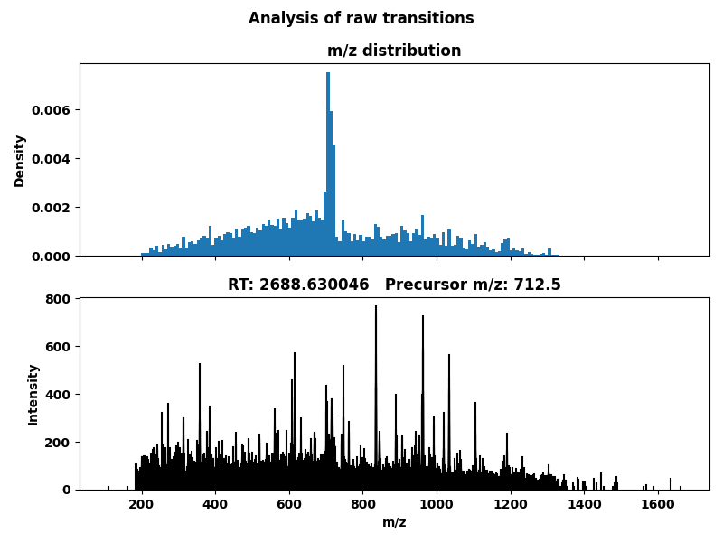
RT: 2688.63 - distribution of transitions as a factor of m/z

Slide 10
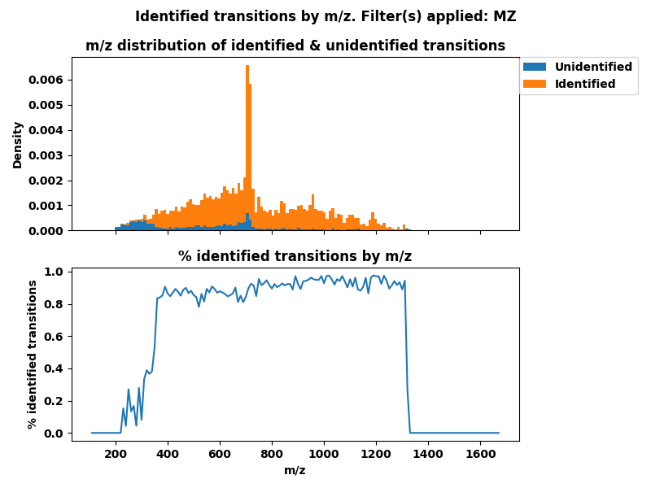
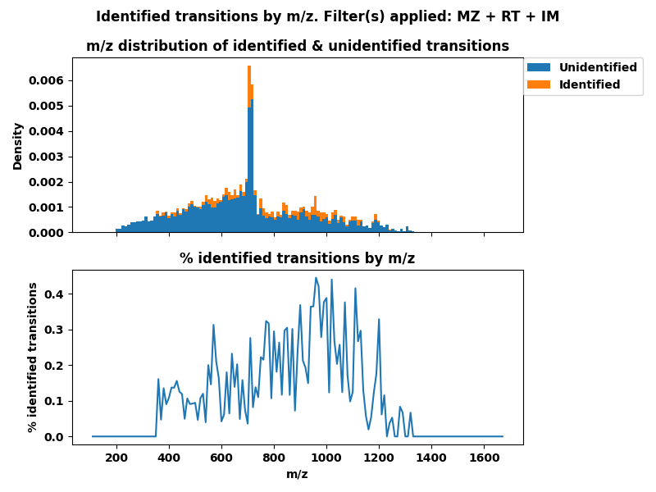
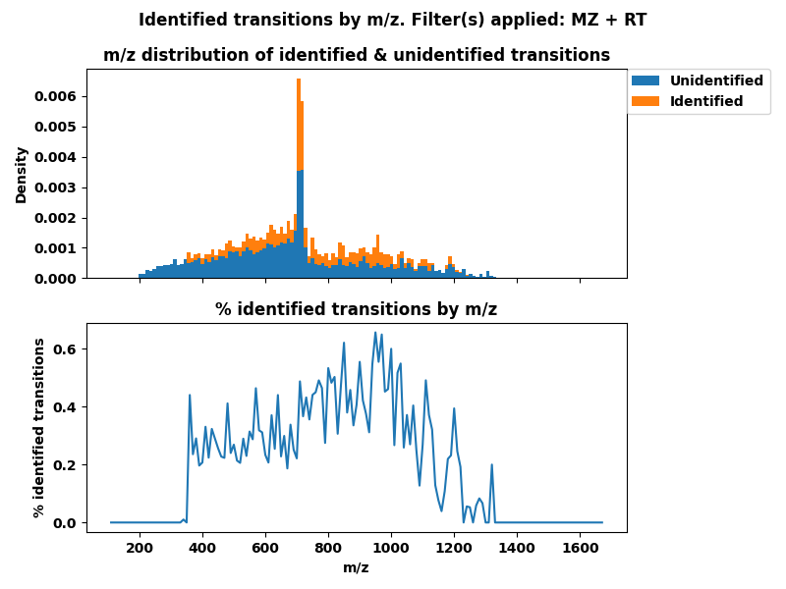
RT: 2688.63 - % identified peaks as a factor of m/z

Slide 11
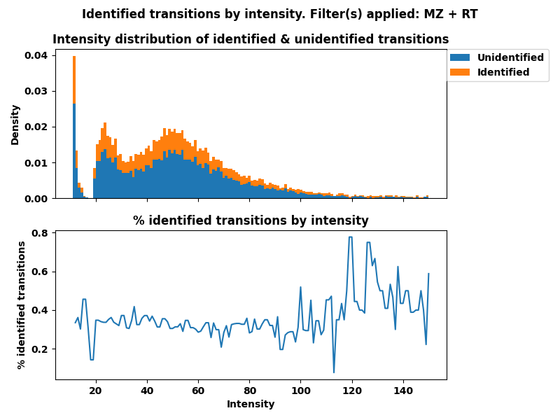
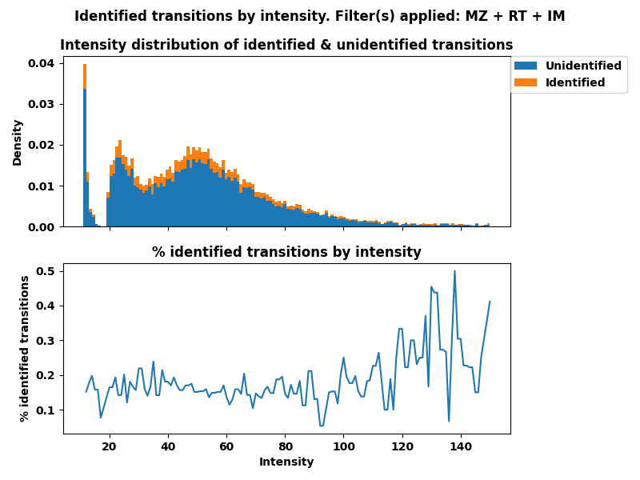
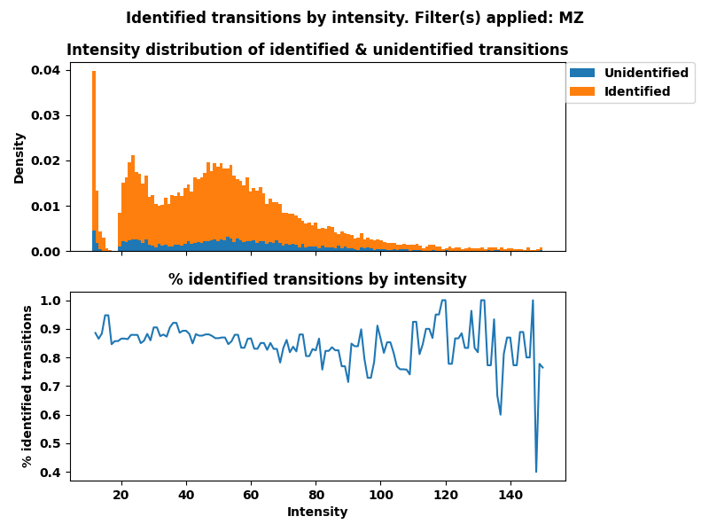
RT: 2688.63 - % identified peaks as a factor of intensity

Slide 12
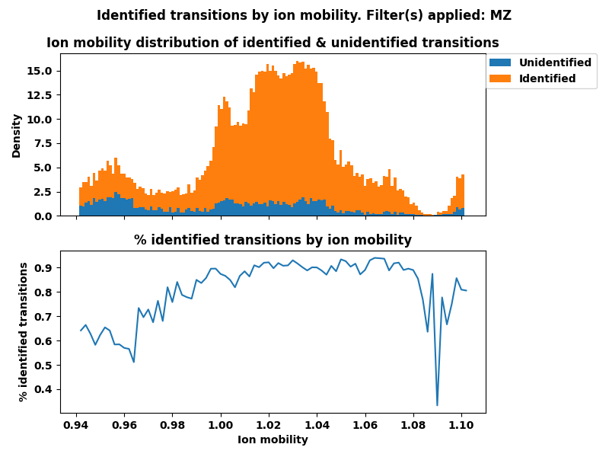
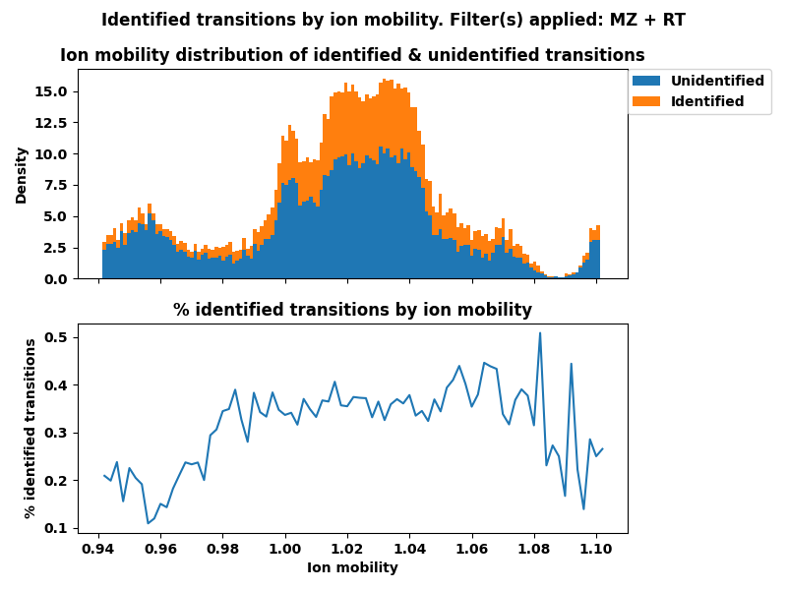
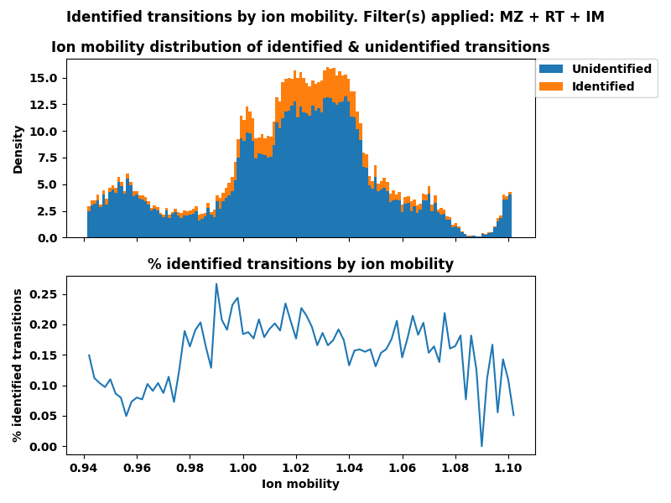
RT: 2688.63 - % identified peaks as a factor of ion mobility

Slide 13
Summary
Join tables within .osw file
Isolate significant transitions (QVALUE < 0.01)
Map filtered .osw table to raw transitions in .mzML file
Mapped raw transitions: mean of significant transitions across RT 2400-2700:
m/z (+/- 20ppm) : 81.8%
m/z + RT : 28.5%
m/z + RT + IM (+/- 0.05) : 15.0%
Looking at one spectrum (RT: 2688.63)
Intensity and ion mobility appear to not influence OpenSWATH’s selectivity.
m/z appears to influence selectivity
Raw transitions appear at 200 m/z, but significant transitions appear after 350 m/z

Slide 14
Fin

